Slide 1
Metro State University HAB-16 (& 17) (High altitude Balloon Flights – 16 & 17) Launch
31 🎃ct 2020
Randy Owen
Updated: 21 Oct 2020

Slide 2
Current Launch Info
Launch Site: Wiggins CO
Balloonsats onsite: NLT 6:00 AM
Launch Time: ~7:30 AM

Slide 3
Balloonsat Launch Timeline
Friday 30 Oct :
Launch site and date are subject to change at the last minute
Verify flight is still scheduled for Saturday AND that the launch site is currently Wiggins
Sat 31 Oct:
NLT 6:00 AM – All Balloonsats at launch site
7:00 AM – Balloonsats ready to be put onto flight string.
Teams can continue to make last minute fight preparations after stringing, but DO NOT leave a significant amount of work for this time.
7:30 AM – Launch of first string (EOSS-303)
8:00 AM – Caravan to rally point
9:00 – 10:00 AM – Anticipated payload landing time
11 AM – 2:30 PM – Recovery complete

Slide 4
Info for Students
Verify that the launch is still proceeding as planned the night before launch
Link to EOSS page for our flight: http://www.eoss.org/node/3793
Our flights is designated EOSS-303 Heavy or 303 Lite & 304 Lite
Jim Langsted is our EOSS flight director
Dress appropriately for the weather and walking
Meet at the Wiggins launch site by 6:00AM (90 minutes before launch)
Notify Randy when your team arrives for updated instructions
If you have a problem on Saturday call (not text) Randy (or Tiffany)
Randy’s cell: 720.933.3527
Tiffany’s cell:

Slide 5
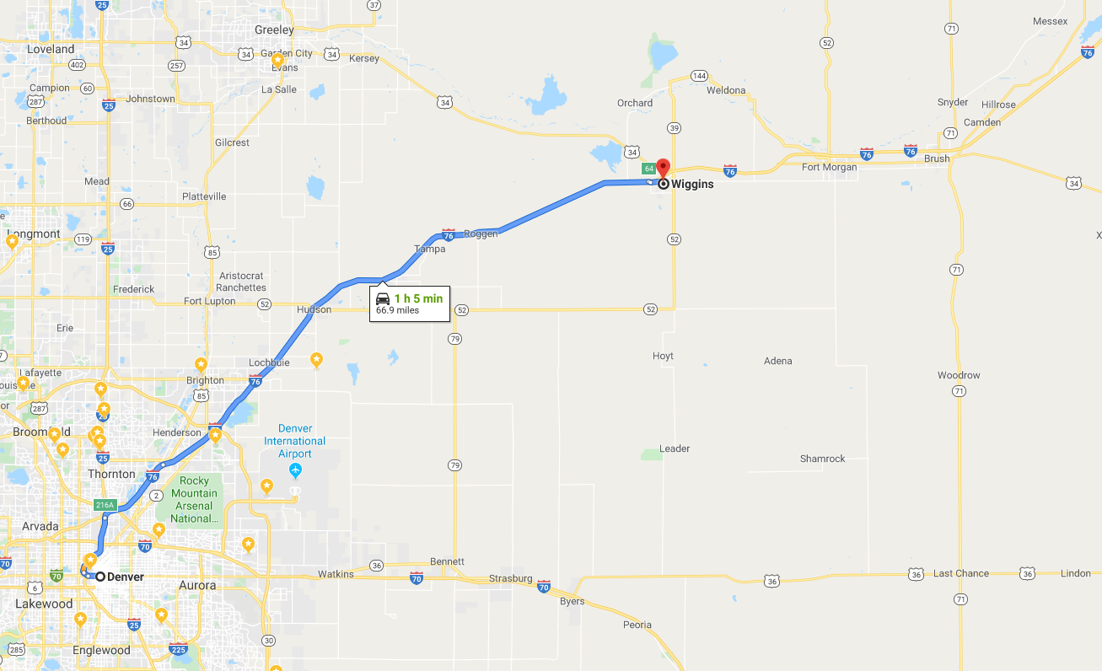
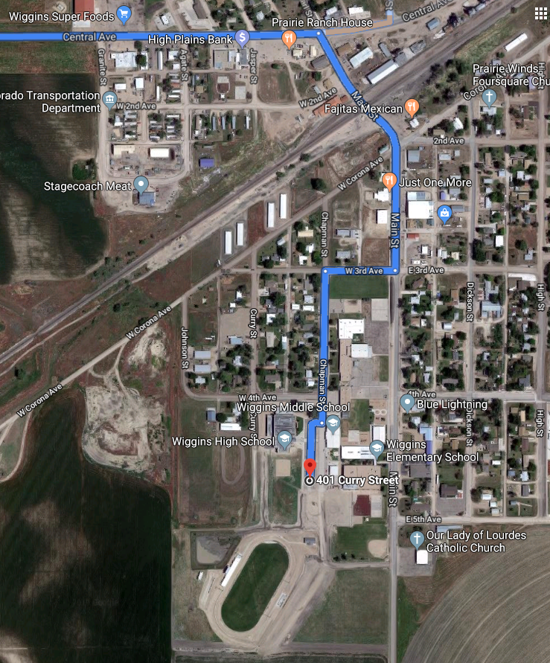
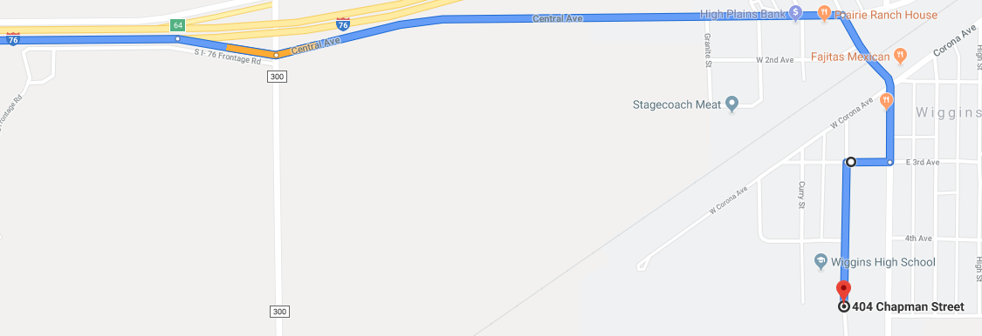
Wiggins Launch Site EOSS link to launch site info
Exit 64

Slide 6
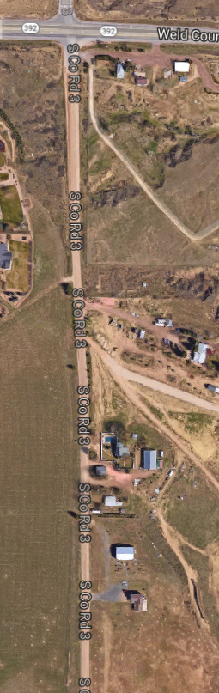
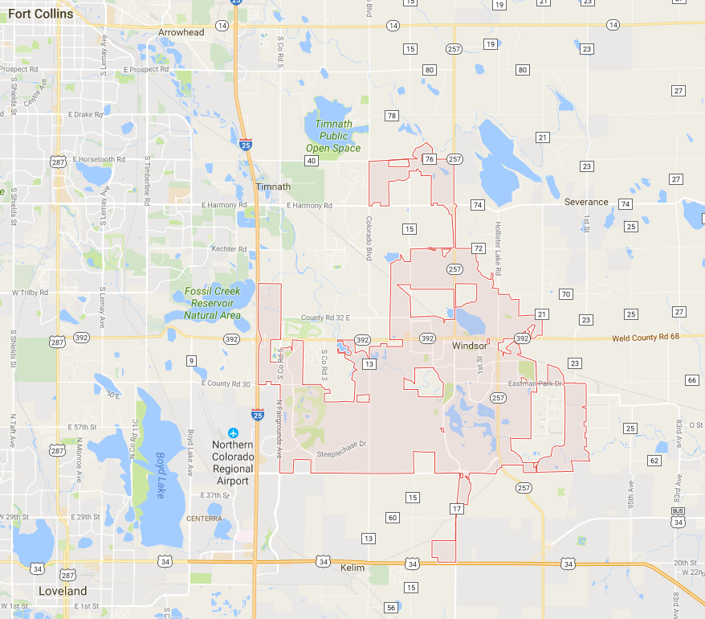
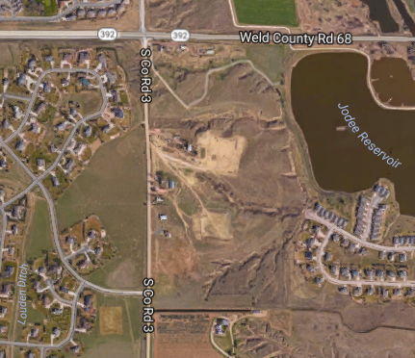

Windsor Launch Site http://eoss.org/launchsites/windsor

Slide 7
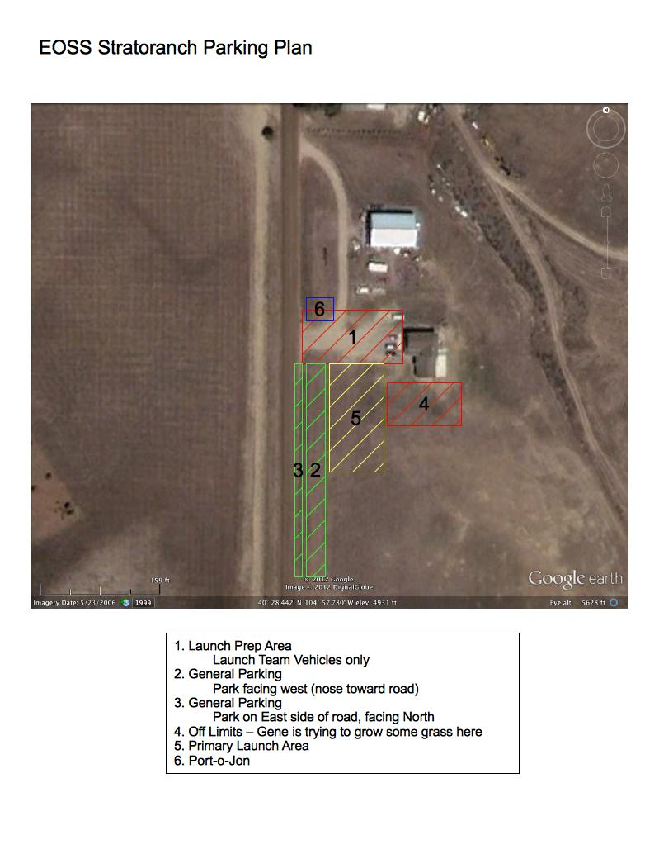
Windsor Launch Site Parking Plan http://eoss.org/launchsites/windsor
Park in Areas 3 & 4 only
Then proceed to Area 5

Slide 8
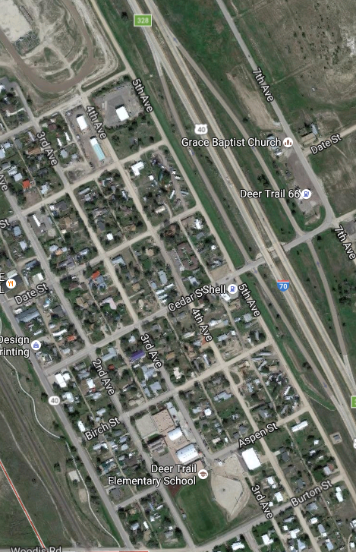
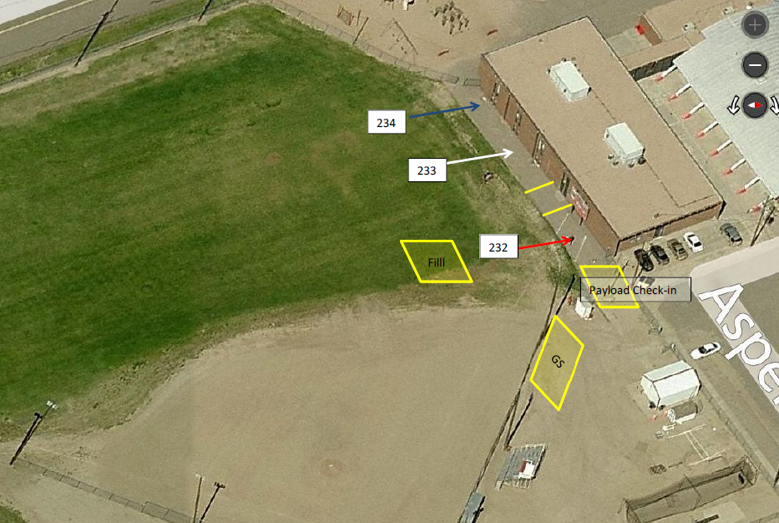

Deer Trail (Backup) Launch Site
Exit 328
Last Gas Station for a million miles!!!

Slide 9
Info for Students (cont)
Be prepared to be in the field past lunch time, with snacks or food and water
Dress in layers, temperatures may be quite cool in the morning, and warm by the time the payloads are recovered
Wear sturdy shoes and long pants we will be going into the field to recover payloads and you may be hiking through tall brush or crossing fences
In the event of any emergency, please notify an MSU instructor or staff member if not available notify an EOSS member, they usually carry first aid kits for minor medical needs and can provide emergency communications in the event that cell phones do not work

Slide 10
Info for Students (cont)
Be sure all chase vehicles have a full tank of gas.
From preliminary predictions based on climatological data, our balloons are expected to go ~40 miles downrange.
Balloon landings take us to areas where fuel is not readily available. If someone runs low on gas, they may miss out on some of the fun.
Please drive carefully!
Farm vehicles and large trucks share the backroads, but sometimes they do not expect us out there. Road shoulders may be soft and muddy, so it may be best to stick to the road bed when pulling over or turning around.
We will be on rural DIRT ROADS
Plan accordingly when deciding who’s vehicle to take
If it’s dry visibility may be limited due to dust thrown up by vehicles
PAY ATTENTION for stops
Do not drive too close
If you fall behind get on the radio and ask for leader to slow down
FRS radio may not have sufficient range to reach front car
Relay any communications to the front
Be sure all chase vehicles have a full tank of gas (yes, I know I am repeating myself)

Slide 11


Things to bring:
Colorado Benchmark Road & Recreation Atlas
Colorado Atlas & Gazetteer
by DeLorme Mapping Company
Your Balloonsat
Lunch and Snacks
Water or drinks
Paper map of Colorado
Good ones →
Available at Barnes and Noble
and Jax Sporting Goods
Sturdy walking shoes - Tennis Shoes are Highly Discouraged
We may have to walk a mile or more on undeveloped prairie
Barb wire, water run off gullies, animal burrows, cow pies
Sunscreen
FRS Radio for caravan communications (we provide these, but if you have one feel free to bring it)
Rain gear
Binoculars
Cameras – take lots of pictures and videos!
Extra batteries
Cell phone chargers
Most of all bring a good supply of fun and an interest in science!

Slide 12
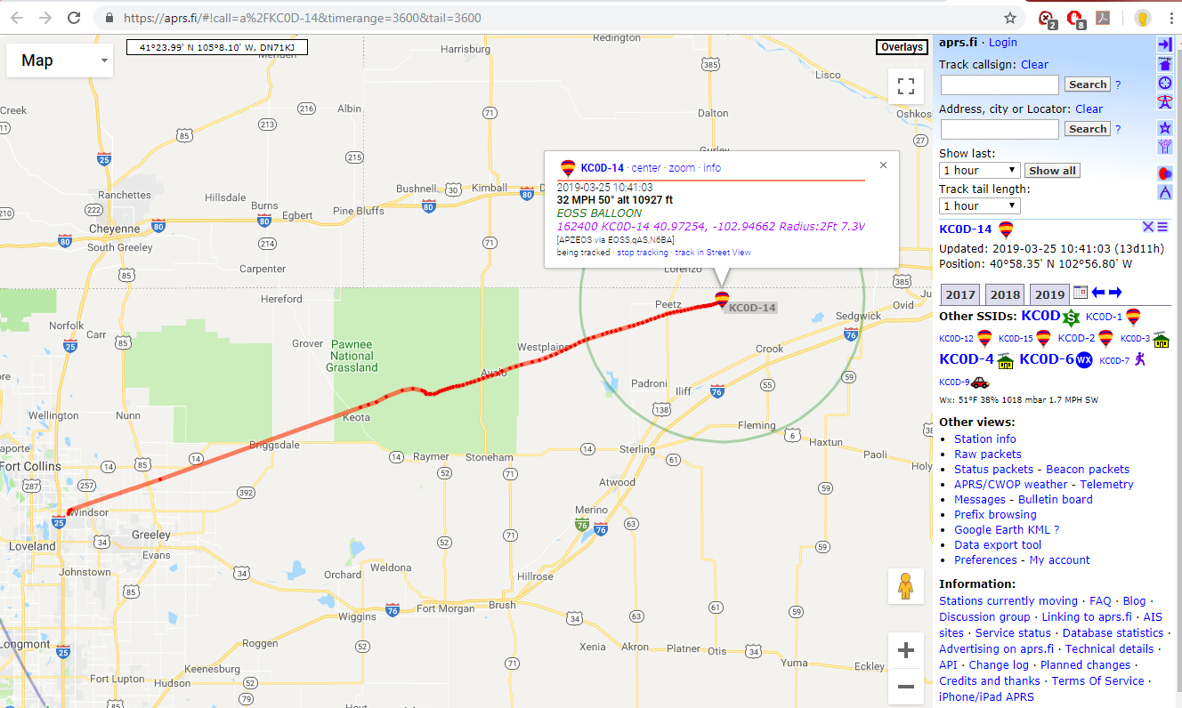
Tracking the balloon on the Internet
Tracking the balloon on the Internet
The EOSS-303 (&304) balloon positions should be visible on the internet at (load on your phones):
www.wxqa.com/sss/balon1.cgi
Anyone interested can watch from home or from their cars if they have data coverage. Recommend that you preload the balloons before Saturday
Cell phone coverage may be intermittent or unavailable.

Slide 13
Friends and Family
Invite whomever you like to come to the launch and recovery
Children must be supervised, so if you bring a child also bring someone to watch them while you are busy getting your Balloonsat ready to fly
Be sure to give everyone the web info for tracking from home too

Slide 14
Recovery
We will try form up shortly after launch (20 – 25 minutes) and proceed to the field.
I will hand out FRS radios (one per car) and maps.
An EOSS member will lead the payload recovery caravan into the field. EOSS will attempt to guide and maintain everyone following
- or -
We will meet at a specific location and time (Rally Point)
The payloads will return to earth between 9:00 AM and 10:00 AM, however delays in reaching and recovering the payload may stretch into the early afternoon and returning home may take some time depending on the distance flown.

Slide 15
Recovery (cont)
Jim will be in communication with the tracking coordinator (Alpha), and EOSS will likely drive toward the field, and station at a rally point (pull over and park somewhere safe) until Alpha directs us in by the best path.
It is important that NO ONE leaves the road or crosses onto private property without permission
EOSS tries very hard to respect the landowner’s rights where we operate
They will contact the landowners and let us know when we have permission to enter and recover the payload.
In the event that someone gets separated, EOSS will make attempts to get them back with the party.
If you are lost, Jim’s vehicle should be visible on the web at http://aprs.fi/K0RPS but realize that the position may be a few minutes old.
Additionally any vehicles you see with unusual antennas on it are likely members of our tracking and recovery team.

Slide 16
Transportation to Recovery Site
Teams will leave launch site and meet at a predesignated Rally point
EOSS will pick up teams at rally point and lead to recovery location
Carpool with other students and instructor
Provide vehicle info and passenger list to Flight Lead (probably instructor) before leaving launch site
Arrive at Rally point before designated departure time

Slide 17
Radios
Metro will provide preprogrammed radios for the chase cars
FRS Channel(s) TBD will be used for communicating between cars in the caravan
You may talk between yourselves but remember nobody else can talk if you are
Listen for directions from Jose, Jim, and Randy
Radios will be signed out Saturday morning
One per car
Return before going home Saturday

Slide 18

Info for Students (cont)
Do not touch any other teams Balloonsat
One person must stay with your Balloonsat at all times
At some point EOSS will request that ONE team member from each team bring the Balloonsat to the flight line
Balloonsats will be strung onto flight line
Once stringing is completed the rest of the team may come back
DO NOT STEP ACROSS THE FLIGHT STRING! Walk the whole way around if you need access from the other side of the string
Each team will designate ONE
individual to launch your
Balloonsat
NO SMOKING
Balloons are filled with Hydrogen

Slide 19
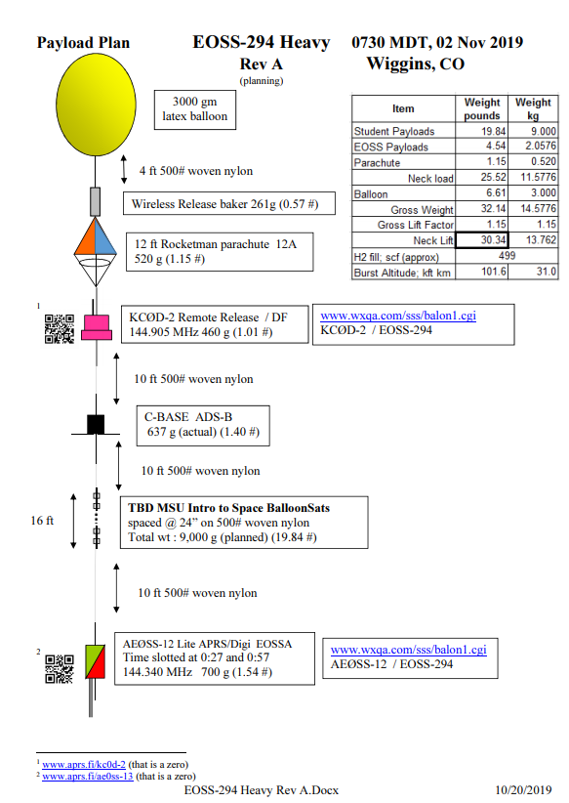
EOSS Info
Flight Info:
http://eoss.org/node/3174
Payload Plan:
http://eoss.org/sites/default/files/payload-plans/EOSS-294%20Heavy%20Rev%20A.pdf

Slide 20
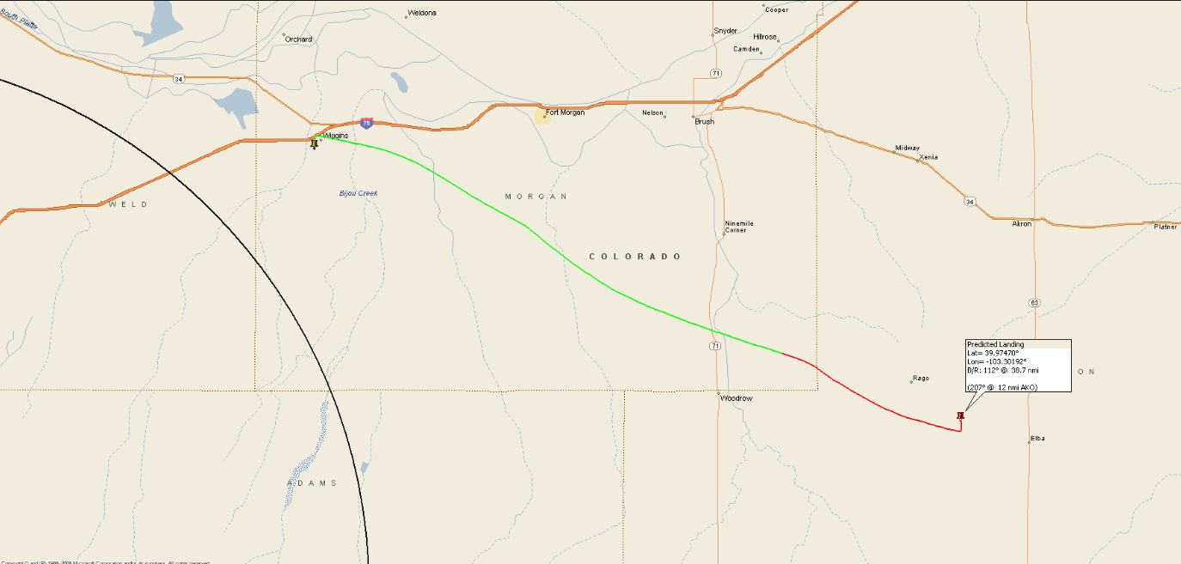
Current Predicted Flight Path
https://eoss.org/predict/e303_010201200264gfs_iggco.gif
For updates go to http://eoss.org/predict
Then find the ‘Wiggins’ line for each balloon. click on the GIF link for the graphic with the coordinates; scroll down for forcast.
GFS Surface / Aloft Conditions Forecast
Site | Forecast | Valid Time | Lo Cld | Md Cld | Hi Cld | Tot Sky | Temp (°F) | Wind (kt) | Precip (in) | Snow Cover (in) | Precip Prob | Trop Hgt (ft) | Max Wind (kt)
Wiggins | 267 hr | 10-31-2020 1500 UTC | 14% | 6% | 4% | 22% | 38 | 290° @ 0 G 5 | 0.00 | 1 | 0% | 48059 | 152° @ 23 41793 ft
Windsor | 267 hr | 10-31-2020 1500 UTC | 13% | 6% | 4% | 21% | 38 | 288° @ 0 G 5 | 0.00 | 1 | 0% | 48157 | 152° @ 22 41883 ft
Deer Trail | 267 hr | 10-31-2020 1500 UTC | 13% | 6% | 4% | 22% | 38 | 293° @ 0 G 5 | 0.00 | 1 | 0% | 48376 | 153° @ 23 41193 ft

Slide 21
GFS Surface / Aloft Conditions Forecast
Site | Forecast | Valid Time | Lo Cld | Md Cld | Hi Cld | Tot Sky | Temp (°F) | Wind (kt) | Precip (in) | Snow Cover (in) | Precip Prob | Trop Hgt (ft) | Max Wind (kt)
Wiggins | 267 hr | 10-31-2020 1500 UTC | 14% | 6% | 4% | 22% | 38 | 290° @ 0 G 5 | 0.00 | 1 | 0% | 48059 | 152° @ 23 41793 ft
Windsor | 267 hr | 10-31-2020 1500 UTC | 13% | 6% | 4% | 21% | 38 | 288° @ 0 G 5 | 0.00 | 1 | 0% | 48157 | 152° @ 22 41883 ft
Deer Trail | 267 hr | 10-31-2020 1500 UTC | 13% | 6% | 4% | 22% | 38 | 293° @ 0 G 5 | 0.00 | 1 | 0% | 48376 | 153° @ 23 41193 ft

Slide 22
Remember!!!
Be Polite and Respectful to EOSS
Remember that they are all volunteers
They are giving YOU their Saturday
Without them our launch would not be possible
Treat them with respect and gratitude for their support
Follow all instructions
Please see me ASAP if you have any issues

